Slide 1
2024 Point in Time Count & Housing Inventory
The basics for providers & community leads

Slide 2
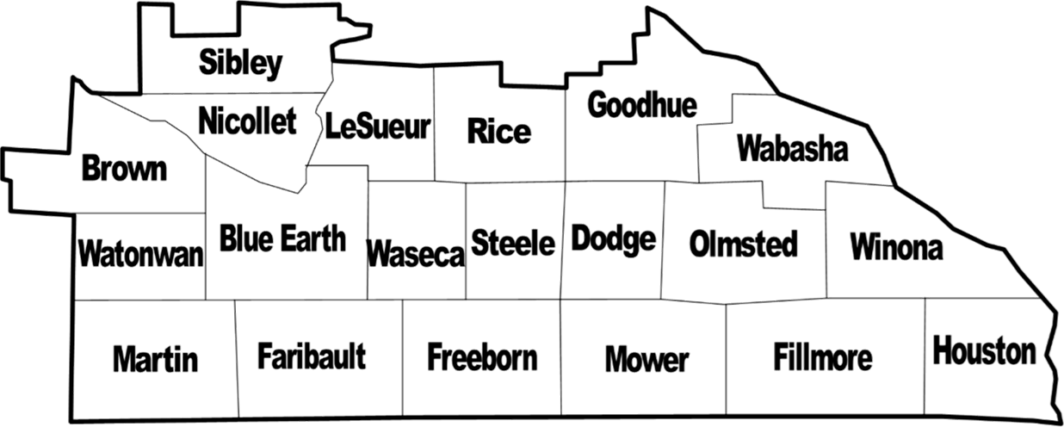
River Valleys Continuum of Care
What we are:
Where we work:
Community-based coalition dedicated to working together to prevent and end homelessness in southern Minnesota
And,
A Continuum of Care region recognized by the U.S. Department of Housing and Urban Development for the purposes of the HUD Continuum of Care funding program.
The CoC's formal name with HUD is Rochester/Southeast Minnesota CoC (MN-502).

Slide 3
Topics for today
When is the Count?
Why do we count?
What and who is involved?
Housing Inventory
Person Count
What happens next?
Where can I find help?

Slide 4
When is the Count?
Night of
Wednesday, January 24, 2024
January
24

Slide 5
What happens during the Count?
Point in Time Count
Housing Inventory Count
Beds
Units
Count people and households
Count program capacity

Slide 6
Why do we do a Count?
PIT Count 101
To measure and monitor trends and changes in homelessness on local and national levels
To help our community understand what resources we have and need, and to strategize best ways to use them
To comply with federal regulations and requirements
Notes:
This slide outlines 3 main reasons that CoCs conduct the PIT count: to monitor how homelessness changes from year to year, to assist with local planning efforts, and to meet HUD’s requirements. You may want to add local reasons.
You may consider also telling volunteers about where the PIT count data go and how your CoC uses PIT count data to inform system planning.
All Annual Homeless Assessment Report (AHAR) data and reports can be found on HUD Exchange: https://www.hudexchange.info/homelessness-assistance/ahar/
River Valleys CoC data and reports can be found on our website: https://www.rivervalleyscoc.org/data--reports.html

Slide 7
Housing Inventory
Count Part 1: Counting available housing

Slide 8
Wait! I thought this was about counting people…
It is, but …
To make sure EVERY PERSON counts, we must know where to count. Consider, what locations should be included in your community this year? Has anything changed since last year?
Last Year
This Year
Unsheltered locations
Shelters & Housing Programs
Notes:
Possible discussion area: What new locations may be good to include this year? What locations may not be needed this year?

Slide 9
Housing Inventory Count (HIC)
Inventory of provider programs within a CoC that provide beds and units dedicated to serve people experiencing homelessness
HIC inventory is for the same night as the PIT Count: January 24, 2024
Includes all housing projects (regardless of funding source) where:
The primary intent of the project is to serve homeless persons
The project verifies homeless status as part of its eligibility determination
The actual project clients are predominantly homeless (or, for permanent housing, were homeless at entry)
Notes:
HUD, State, Local, or private funding sources. Includes programs that do not use HMIS – DV programs.

Slide 10
What Programs Are Included in the HIC?
Emergency shelters, including DV shelters and hotel units and campground spaces paid for with an emergency shelter vouchers
Transitional housing for homeless persons
Rapid re-housing programs that provide short- or medium-term assistance to homeless persons
All permanent supportive housing for formerly homeless persons. Examples: CoC PSH, MN Housing HPH units, MN Department of Human Services LTH vouchers, VASH, etc.
Residential programs for the homeless funded by private organizations
Faith-based residential programs for the homeless
Interfaith hospitality networks serving homeless persons
What these locations have in common:
Homeless eligibility
Overnight stay
Not self-pay
What might be different:
Funding source
HMIS use
Target population
Property/ project model
Notes:
Note: All emergency shelter and transitional housing projects that are included on the HIC will also report numbers for the sheltered PIT Count.
People included in the sheltered PIT Count must be staying in an emergency shelter or transitional housing project that is eligible to be included in the HIC.

Slide 11
What Projects Are NOT Included in the HIC?
Tenant-based housing provided by the Housing Choice Voucher program, unless the voucher(s) has been exclusively dedicated to serving homeless persons.
Project-based public housing, unless the housing has been exclusively dedicated to serving homeless persons.
Medical facilities where persons are admitted for care (hospitals, psychiatric facilities, nursing homes, etc.).
Jails, prisons or juvenile detention facilities.
Foster care homes or foster care group homes.
Market rate units that happen to accept formerly homeless persons.
Chemical dependency facilities, such as substance abuse treatment facilities and detox centers.
Notes:
Note: All emergency shelter and transitional housing projects that are included on the HIC will also report numbers for the sheltered PIT Count.
People included in the sheltered PIT Count must be staying in an emergency shelter or transitional housing project that is eligible to be included in the HIC.

Slide 12
How are the PIT and HIC Related?
The number of sheltered people counted in the PIT must equal the number of sheltered people counted in the HIC.
All projects where people are counted in the sheltered PIT must be included in the HIC.
Connecting the two allows us to understand how shelter and housing resources are being used.
Point in Time Count (PIT)
Housing Inventory (HIC)
PIT + HIC
Notes:
HIC = beds & units available
PIT = people experiencing homelessness or recently homeless (in RRH, OPH, or PSH)
Agencies participating in the count must think about both parts.
Example on the slide
6 people experiencing homelessness: 3 unsheltered, 3 in shelter X
Shelter X has 4 beds
Together, we can see that the shelter was 75% occupied (3 of 4 beds in use). (Can use same example with TH, RRH, OPH, or PSH).
Knowing the occupancy rate allows us to explore why three people remained unsheltered while a bed was available and improve how we work together.

Slide 13
How do projects report for the HIC?
Review the list of housing projects
Full 2023 regional list: https://www.rivervalleyscoc.org/hic-reports.html
Identify if the list is correct or if it needs to be updated
Are all current programs listed?
Are there any new housing your offer?
Have any programs ended or changed size?
Can your program serve a different number of people now?
Have funding sources changed?
Submit changes to Jennifer by email with subject HIC Update [Project/program name] by January 12.
Notes:
Want permanent housing programs to update – Check with Jennifer.

Slide 14
What can others do to help with the HIC?
Review the 2023 Housing Inventory for your community <LINK>
1
Connect the CoC with programs that weren’t included last year
2
New shelters
COVID-specific shelter/housing
Other privately-funded programs that meet the criteria in the earlier slides
Send updates and questions to Jennifer by January 12
3
Add to Online Inventory <LINK>
Send by email

Slide 15
Point in Time Count
Count Part 2: Counting people experiencing homelessness

Slide 16
What is the PIT Count?
A literal count of all the people experiencing homelessness in our community on a single night (i.e., at a point in time)
Conducted by every community nationwide with in the last 10 days of January at least every other year.
In Minnesota, usually on the 4th Wednesday of January.
A “snapshot” of homelessness on this one night in our community
Notes:
Using HUD Definition of homelessness. Definition of homeless used:
Regional decision to count or not count doubled up – River Valleys CoC has decided not to do a doubled-up count on a regional level because many areas don’t have capacity to do that, and it’s not required for HUD. If a specific county/community wants to do it and submits those surveys in the survey form, we can make that data available to the community with caution about identifying individuals in the data. Otherwise, we refer communities to our Coordinated Entry data summaries and Wilder studies for better estimates of doubled-up numbers.

Slide 17
Where are people counted?
Housed
Outdoors
Sheltered
Unsheltered locations
Permanent Supportive Housing
Transitional Housing
In non-housing locations
Self-identified while seeking services
Coordinated Entry outreach
Emergency Shelter
Rapid Rehousing
Other designated housing for people experiencing homelessness
Formerly Homeless
Homeless

Slide 18
Who participates in the Count?
HMIS & Non-HMIS Providers
Outreach Teams & Volunteers
Emergency Shelter, including
Hotel/Motel Vouchers
Domestic violence shelters
Temporary or COVID shelters
Transitional Housing
Rapid Re-Housing
Permanent Supportive Housing
CE Navigators
CoC Leadership
ICA (Institute for Community Alliances) – HMIS database administrator
Notes:
For support with outreach and volunteers – communities have considered:
Public Safety included to support street outreach.
School or districts – Homeless Liaison, social workers – schools knowing who is unsheltered vs sheltered.

Slide 19
What options do we have for the unsheltered count?
Service Based Count
Outreach/promotion before count
Surveys at many locations in community
Multiple days to collect data
Event Based Count
Outreach/promotion before count
Resource Fair activity with surveys
1-2 day data collection
Street Outreach Based Count
Survey conducted by outreach staff
1 night data collection
Notes:
What ideas agencies have for what has been successful in getting a good count – what have you done before, who haven’t you connected with that you believe would be a good partners…
Outreach for counting people and where people can go to get counted. Public safety have staff that already know where homeless are gathering.

Slide 20
How is the count completed?
UNSHELTERED count
Sheltered & Housed Count
Each Homeless Response Team or county-level team chooses at least one approach:
Street Outreach-Based Count
Event-Based Count
Service-Based Count
AND, Coordinated Entry List Outreach contacts people who may be experiencing homelessness
Projects using HMIS:
Ensure data in HMIS is complete & correct for night of January 24
Regional report will collect all aggregate data
Projects that don’t use HMIS:
Count stayers (all)
Report demographics (Shelter & Transitional Housing)
Submit an online form (all)
Notes:
Communities doing an event this year:
Communities should let Jennifer know if they will be conducting street outreach activities.
When presenting this slide – all options should be presented and then connect made to make sure we make every effort to get people counted.

Slide 21
When is Count data collected?
Wednesday Night
Street outreach/ known locations
Thursday
Event-based counts*
Service-based counts begin
Friday – Tuesday
Service-based counts continue
Wednesday – Friday
Street outreach and event-based counts begin data entry
Data entry continues/ completed
January 24
January 25
January 26 -30
January 31 – February 2
January
24
Notes:
Understanding a sense of urgency – not thinking we have a week and half to collect.

Slide 22
What’s Next for November/December?
Shelters & Housing Programs
Local Count Teams
Review your program or agency list on the 2023 Housing Inventory
Are all current programs listed?
Are there any new housing your offer?
Have any programs ended or changed size?
Can your program serve a different number of people now?
Have funding sources changed?
Contact Jennifer by January 12 if you have changes
Gather your Homeless Response Team
Help your Homeless Response Team review options for the UNSHELTERED Count and select at least one
Street outreach-based count
Event-based count
Service-based count
Identify all count locations in your community
Unsheltered outreach locations
Changes to Emergency Shelters & Housing Programs
Send updates and questions to Jennifer by January 12
Identify if volunteers are needed for your count & start recruiting
Notes:
Housing Inventory Link: https://docs.google.com/spreadsheets/d/1o8L6prpiaTE-4s1WO4Xf6nsfwh0xYIKlpxFOqnIwxxw/edit?usp=sharing

Slide 23
What’s up for today?
Housing Inventory
Unsheltered Point in time count
Gather with a small group from your area of the region
Review your program or agency list on the 2023 Housing Inventory
Are all known programs listed?
Are there any new housing programs in your community?
Has contact information changed recently?
Use the COMMENT function on the Google doc to note changes in your community
Identify your local Homeless Response Team contact
Discuss:
Status of 2024 count plans, if any
What new approaches may be needed to
Ensure everyone is counted. Examples: New locations? Targeted outreach?
Staff and volunteers are ready and trained
Participants, staff and volunteers remain safe & healthy
Identify all count locations in your community
Notes:
Tailor this slide to your own set of decision-points or action steps

Slide 24
Resources
River Valleys CoC
Contact: Jennifer Prins
CoC Coordinator
jennifer.prins@rivervalleyscoc.org
Toolkits & Calendars
will posted on the CoC website
https://www.rivervalleyscoc.org/point-in-time-count.html
HMIS Questions
ICA (HMIS Helpdesk)
mnhmis@icalliances.org
Survey Materials and Guides are posted in January at https://www.hmismn.org/point-in-time-count

